Slide 1
CS210: Computer Science II

Slide 2
Unit 1 Module 3:
CLASSES
Defining Classes and Member Functions
Introduction to Classes
Defining an Instance of a Class
Why Have Private Members?
Separating Class Specification from Implementation
Inline Member Functions

Slide 3
Unit 1 Module 4: CLASSES
Constructors
Passing Arguments to Constructors
Destructors
Overloading Constructors
Private Member Functions
Arrays of Objects/Classes – Dynamic too
Public and Private Members
Efficiency notes regarding Classes

Slide 4
Object-Oriented Programming Terminology
class: like a struct (allows bundling of related variables), but variables and functions in the class can have different properties than in a struct
object: an instance of a class, in the same way that a variable can be an instance of a struct

Slide 5
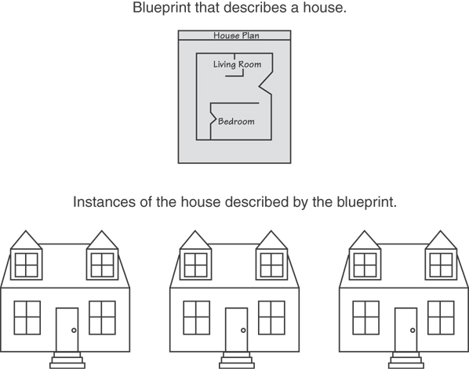
Classes and Objects
A Class is like a blueprint and objects are like houses built from the blueprint

Slide 6
How to Think About Objects
At the conceptual level
An object is a set of responsibilities
At the specification level
An object is a set of methods that can be invoked by other objects or by itself
At the implementation level
An object is code and data

Slide 7
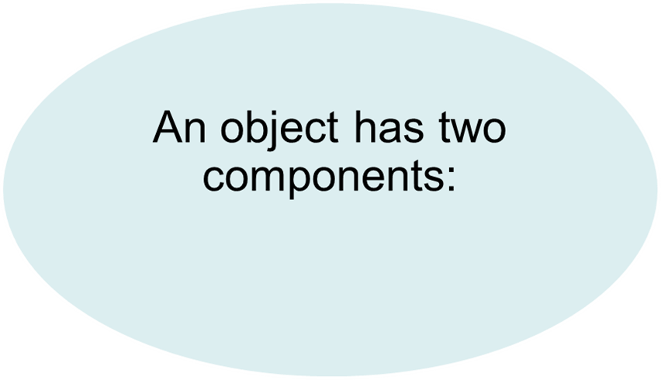
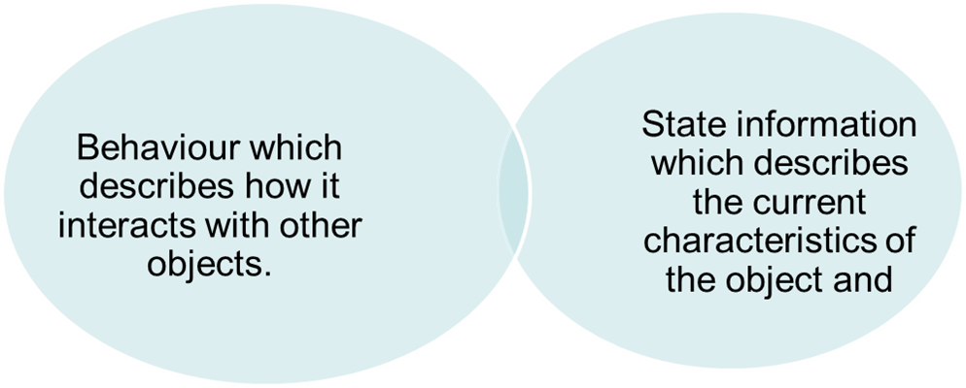
Object-Oriented Programming Terminology
attributes: members of a class
methods or behaviors: member functions of a class

Slide 8
Object-Oriented Programming Terminology
encapsulation: methods of a class provide all the interface to the object’s data
methods from outside of the class DO NOT interface
Methods encompass all the knowledge of the particular object

Slide 9
More on Objects
data hiding: restricting access to certain members of an object
public interface: members of an object that are available outside of the object. This allows the object to provide access to some data and functions without sharing its internal details and design, and provides some protection from data corruption
Private – only can be accessed by methods of the object
Public – accessible by outside methods

Slide 10
Objects
class
Time
inToWork
hour
minute
void addMinutes( int m )
Attributes: hour = 8 minute = 30 Methods: void addMinutes(int m)
outFromWork
Attributes: hour = 17 minute = 35 Methods: void addMinutes(int m)
objects

Slide 11
Inheritance
Animals
Mammals
Primates
Humans
Monkeys
Supertype
Food
Blastula
Warm blooded
Mammary glands
Five fingers
Thumbs
Highly developed brains
Erect

Slide 12
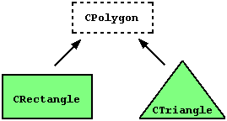
Inheritance
Provides a way to create a new class from an existing class
The new class is a specialized version of the existing class
A
B
C
A
A
B
B
C
C
D

Slide 13
The "is a" Relationship
Inheritance establishes an "is a" relationship between classes.
A poodle is a dog
A car is a vehicle
A flower is a plant
A football player is an athlete

Slide 14
The “has a" Relationship
Inheritance is not established in a “has a" relationship between classes.
A car has a brake petal
A house has a garage
A flower has a stem
A football player has a helmet

Slide 15
Introduction to Classes
Objects are created from a class
Format:
class ClassName
{
declaration;
declaration;
};

Slide 16
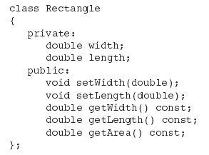
Class Example
Notice const - the function will not change any data stored in the calling object.

Slide 17
Access Specifiers
Used to control access to members of the class
public: can be accessed by functions outside of the class
private: can only be called by or accessed by functions that are members of the class

Slide 18
Class Example
Private Members
Public Members

Slide 19
More on Access Specifiers
Can be listed in any order in a class
Can appear multiple times in a class
If not specified, the default is private

Slide 20

Using const With Member Functions
const appearing after the parentheses in a member function declaration specifies that the function will not change any data in the calling object.

Slide 21
Defining a Member Function
When defining a member function:
Put prototype in class declaration
Define function using class name and scope resolution operator (::)
int Rectangle::setWidth(double wVar)
{
width = wVar;
}

Slide 22
Accessors and Mutators
Mutator: a member function that stores a value in a private member variable, or changes its value in some way
Accessor: function that retrieves a value from a private member variable. Accessors do not change an object's data, so they should be marked const.

Slide 23
Defining an Instance of a Class
An object is an instance of a class
Defined like structure variables:
Rectangle xyz;
Access members using dot operator:
xyz.setWidth(5.2);
cout << xyz.getWidth();
Compiler error if attempt to access private member using dot operator

Slide 24
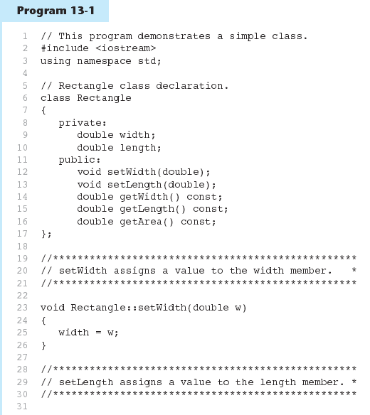

Slide 25
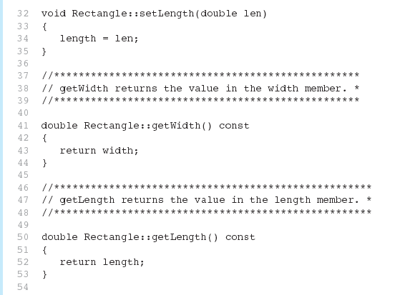

Slide 26
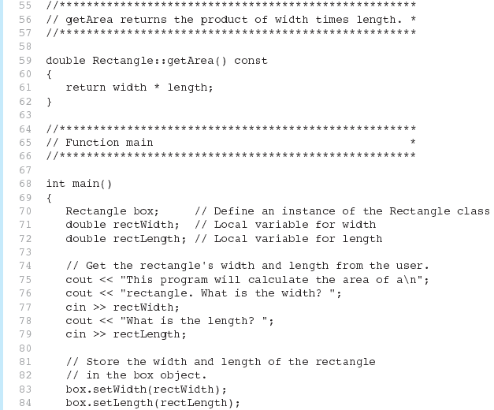

Slide 27
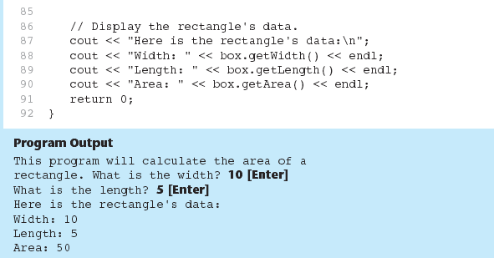

Slide 28
Avoiding Stale Data
Some data is the result of a calculation.
In the Rectangle class the area of a rectangle is calculated.
length x width
If we were to use an area variable here in the Rectangle class, its value would be dependent on the length and the width.
If we change length or width without updating area, then area would become stale.
To avoid stale data, it is best to calculate the value of that data within a member function rather than store it in a variable.

Slide 29
Pointer to an Object
Can define a pointer to an object:
Rectangle *rPtr = nullptr;
Can access public members via pointer:
rPtr = &otherRectangle;
rPtr->setLength(12.5);
cout << rPtr->getLength() << endl;

Slide 30
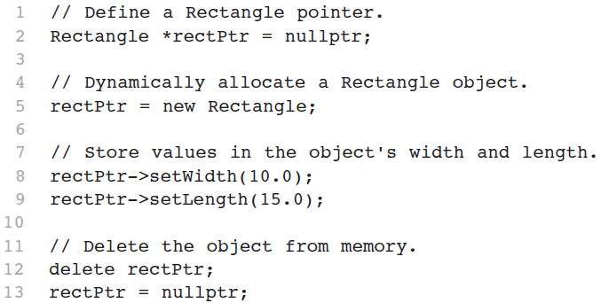
Dynamically Allocating an Object
We can use a pointer to dynamically allocate an object.

Slide 31
Why Have Private Members?
Making data members private provides data protection
Data can be accessed only through public functions
Public functions define the class’s public interface

Slide 32
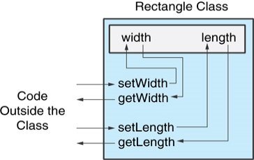
Code outside the class must use the class's public member functions to interact with the object.

Slide 33
Separating Specification from Implementation
Place class declaration in a header file that serves as the class specification file. Name the file ClassName.hpp, for example, Rectangle.hpp
Place member function definitions in ClassName.cpp, for example, Rectangle.cpp File should #include the class specification file
Programs that use the class must #include the class specification file, and be compiled and linked with the member function definitions

Slide 34
Inline Member Functions
Member functions can be defined
inline: in class declaration
after the class declaration
Inline appropriate for short function bodies:
int getWidth() const { return width; }
Note: A function can also be ‘inlined’ if the inline keyword is used.

Slide 35
Rectangle Class with Inline Member Functions
1 // Specification file for the Rectangle class 2 // This version uses some inline member functions. 3 #ifndef RECTANGLE_HPP 4 #define RECTANGLE_HPP 5 6 class Rectangle 7 { 8 private: 9 double width; 10 double length; 11 public: 12 void setWidth(double); 13 void setLength(double); 14 15 double getWidth() const 16 { return width; } 17 18 double getLength() const 19 { return length; } 20 21 double getArea() const 22 { return width * length; } 23 }; 24 #endif

Slide 36
Tradeoffs – Inline vs. Regular Member Functions
Regular functions – when called, compiler stores return address of call, allocates memory for local variables, etc.
Code for an inline function is copied into program in place of call – larger executable program, but no function call overhead, hence faster execution
Inline function definitions are treated differently by the compiler and so they usually run more efficiently, although they consume more storage. With an inline function, each function call in your program is replaced by a compiled version of the function definition, so calls to inline functions do not have the overhead of a normal function call.

Slide 37
Tradeoffs – Inline vs. Regular Member Functions
Inline function definitions are treated differently by the compiler and so they usually run more efficiently, although they consume more storage.
With an inline function, each function call in your program is replaced by a compiled version of the function definition, so calls to inline functions do not have the overhead of a normal function call.

Slide 38
Tradeoffs – Inline vs. Regular Member Functions
Trade off no call versus increase in size
Too large - decrease performance on systems that use paging
For debugging, the names of inlined functions may not be visible at all to the profiler. The result will be misleading reports of which functions take most time.
Small functions are often inlined automatically by the compiler. On the other hand, the compiler may in some cases ignore a request for inlining a function if the inlining causes technical problems or performance problems.

Slide 39
Tradeoffs – Inline vs. Regular Member Functions
Trade off no call versus increase in size
Too large - decrease performance on systems that use paging
For debugging, the names of inlined functions may not be visible at all to the profiler. The result will be misleading reports of which functions take most time.
Small functions are often inlined automatically by the compiler. On the other hand, the compiler may in some cases ignore a request for inlining a function if the inlining causes technical problems or performance problems.

Slide 40
Tradeoffs – Inline vs. Regular Member Functions
An application with many function calls may run slightly faster in 64-bit Linux than in 64-bit Windows. The disadvantage of 64-bit Windows may be mitigated by making critical functions inline

Slide 41
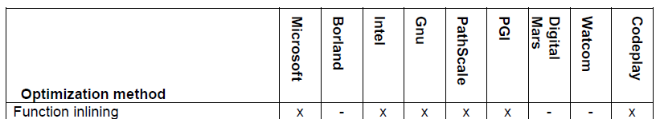
How the compiler optimizes
The compiler can replace a function call by the body of the called function.
float square (float a) {
return a * a;}
float parabola (float x) {
return square(x) + 1.0f;}
The compiler may replace the call to square by the code inside square:
float parabola (float x) {
return x * x + 1.0f;}
The advantages of function inlining are:
The overhead of call and return and parameter transfer are eliminated.
Code caching will be better because the code becomes contiguous.
The code becomes smaller if there is only one call to the inlined function.
Function inlining can open the possibility for other optimizations
The disadvantage of function inlining is that the code becomes bigger if there is more than one call to the inlined function and the function is big. The compiler is more likely to inline a function if it is small or if it is called from only one or a few places.

Slide 42

Constructors
When should we make a member function private?

Slide 43
Memberwise Assignment
Can use = to assign one object to another, or to initialize an object with an object’s data
Copies member to member. e.g.,
instance2 = instance1; means:
copy all member values from instance1 and assign to the corresponding member variables of instance2
Use at initialization:
Rectangle r2 = r1;

Slide 44
Constructors
A class constructor is a special member function of a class that is executed whenever we create new objects of that class. Think of it like a function (w/o return).
Same name as class.
Automatically called whenever a new object of this class is created.

Slide 45
Constructors
Member function that is automatically called when an object is created
Purpose is to construct an object
Constructor function name is class name
Has no return type

Slide 46
Constructors
A default constructor – runs by default and does not have any parameter – by default we mean it is auto generated
class MyClass
{
int x; // no constructor, so the compiler produces an (implicit) default constructor
};
int main()
{
MyClass m; // no error at runtime: the (implicit) default constructor is called
}

Slide 47
Constructors
A code example of both a default and constructor with parameters
class MyClass
{
public:
MyClass();
// parameter-less default constructor
MyClass(int newX, int newY);
// constructor with parameters
more functions…
…
An code example of uses of both (// who gets called)
MyClass aObject; // default
MyClass bObject(72, 89); // parameterized
overloading

Slide 48
Constructors
No default constructor – nothing is auto generated
class MyClass
{
public:
MyClass (int y); // declaration a non-default constructor
…
};
int main()
{
MyClass m(99); // called non-default
MyClass *ptr = new MyClass(); // error
}

Slide 49
Constructors
Recommend:
C++11 a default constructor can be explicitly created
class MyClass
{
public:
myClass () = default;
// force it to generate a non-default constructor
};

Slide 50
Constructors
A copy constructor - called whenever a new variable is created from an object.
Used to:
Initialize one object from another of the same type.
Copy an object to pass it as an argument to a function.
Copy an object to return it from a function.

Slide 51
Constructors
Copy constructor examples:
In the implementation (MyClass.hpp)
class MyClass
{
public:
. . .
MyClass(const MyClass &c); // copy constructor
. . .
const to guarantee that the copy constructor doesn't change it
&
reference because a value parameter would require making a copy

Slide 52
Copy Constructors
Special constructor used when a newly created object is initialized to the data of another object of same class
Default copy constructor copies field-to-field
Default copy constructor works fine in many cases

Slide 53
Copy Constructors
Problem: what if object contains a pointer?
class SomeClass
{ public:
SomeClass(int val = 0)
{value=new int; *value = val;}
int getVal();
void setVal(int);
private:
int *value;
}

Slide 54
Constructors
Copy constructor examples:
Initialize one object from another of the same type.
MyClass a(“Zips”); // constructor is used to build a
MyClass b(c); // copy constructor is used to build b
MyClass c = a; // copy constructor used to initialize in declaration
c = a; // Assignment operator, no constructor/copy constructor
Copy an object to pass it as an argument to a function.
funcA(c); // copy constructor initializes formal value parameter
Copy an object to return it from a function.

Slide 55
Copy Constructors
What we get using memberwise copy with objects containing dynamic memory:
SomeClass object1(5);
SomeClass object2 = object1;
object2.setVal(13);
cout << object1.getVal(); // also 13
13
object1
object2
value
value
These are pointer variables, so during the function call, object1 and object2 point to the same dynamic memory

Slide 56
Programmer-Defined Copy Constructor
Allows us to solve problem with objects containing pointers:
SomeClass::SomeClass(const SomeClass &obj)
{
value = new int;
*value = obj.value;
}
Another view of how it works
StudentTestScores std1 (“Murry Smart”, 9);
StudentTestScores std2 = std1;
Copy constructor takes a reference parameter to an object of the class

Slide 57
Programmer-Defined Copy Constructor
Reference parameter to an object of the class
SomeClass::SomeClass(const SomeClass &obj)
Reference examples:
const int &q = 12; // (1)
int x = 0; // (2)
int &a = x; // (3)
Once a reference is initialized to an object,
it cannot be changed to refer to another object.

Slide 58
Programmer-Defined Copy Constructor
Each object now points to separate dynamic memory:
SomeClass object1(5);
SomeClass object2 = object1;
object2.setVal(13);
cout << object1.getVal(); // still 5
5
13
object1
object2
value
value

Slide 59
Programmer-Defined Copy Constructor
Since copy constructor has a reference to the object it is copying from,
SomeClass::SomeClass(SomeClass &obj)
it can modify that object.
To prevent this from happening, make the object parameter const:
SomeClass::SomeClass
(const SomeClass &obj)

Slide 60
More on Copy Constructor
The copy-constructor is often called X(X&) (“X of X ref”)
- essential to control passing and returning of user-defined types by value during function calls
If you create a class and you want to pass an object of that class by value, how is the compiler supposed to know what to do?

Slide 61
More on Copy Constructor
Bitcopy versus initialization
- The problem occurs because the compiler makes an assumption about how to create a new object from an existing object.
You mediate by defining your own function and prevent the compiler from doing a bitcopy whenever the compiler needs to make a new object from an existing object.

Slide 62
More on Copy Constructor
If you create a copy-constructor, the compiler will not perform a bitcopy when creating a new object from an existing one. It will always call your copy-constructor.
A default copy constructor
Because the copy-constructor implements pass and return by value, it’s important that the compiler creates one for you in the case of simple structures

Slide 63
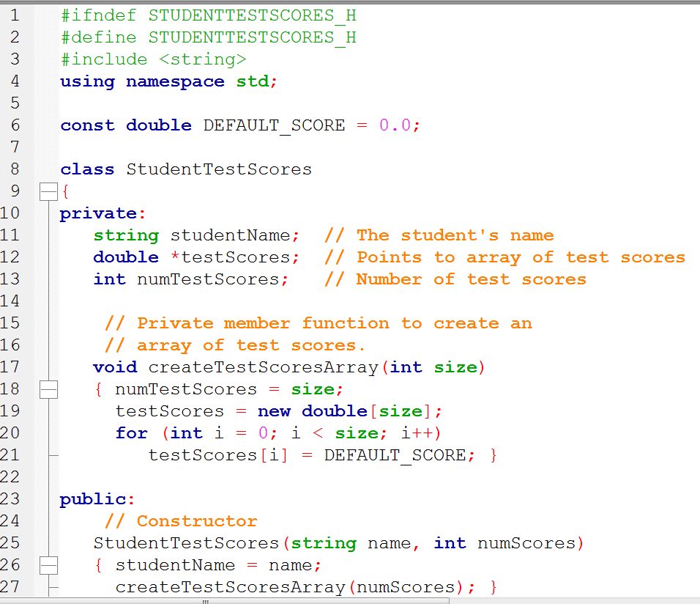

Slide 64
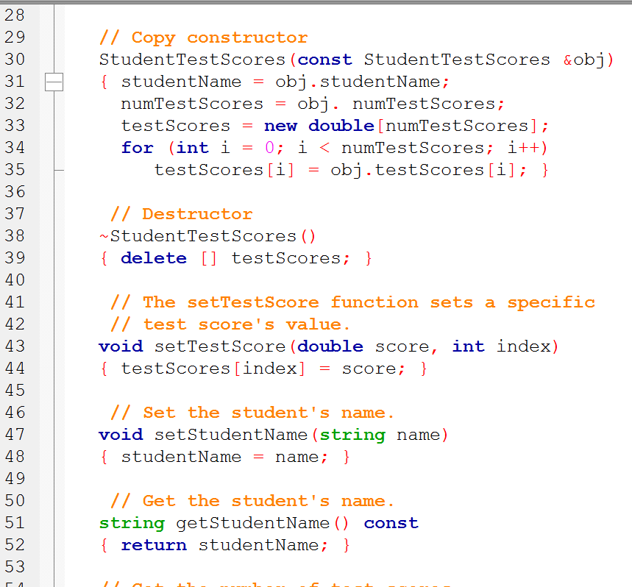

Slide 65
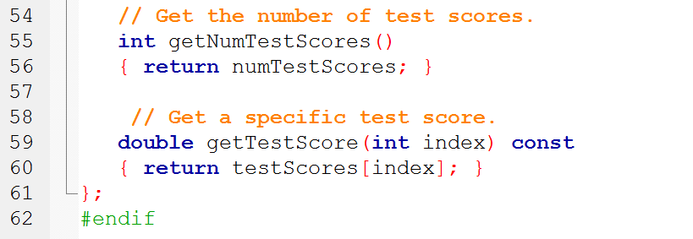
default copy constructor simply copies the contents of member variables. It does not work correctly for classes with pointers or dynamic data in their member variables. If your class member variables involve pointers, dynamic arrays, or other dynamic data, you should define a copy constructor for the class.

Slide 66
Summary: Copy Constructor
Just a constructor (with a reference parm)
1 MyClass(const MyClass &obj)
2 {
value = new int;
*value = obj.value;
}
3 MyClass MyObjOriginal;
.
.
.
MyClass MyObjCopy = MyObjOriginal;

Slide 67
Summary: Copy Constructor
// Copy constructor
1 StudentTestScores(const StudentTestScores &obj)
{ studentName = obj.studentName;
numTestScores = obj. numTestScores;
testScores = new double[numTestScores];
for (int i = 0; i < numTestScores; i++)
testScores[i] = obj.testScores[i]; }
2 StudentTestScores MyNew = MyCreated

Slide 68
Shallow and Deep Copies
Shallow copy
Assignment copies only member variable contents over
Default assignment and copy constructors
Deep copy
Pointers, dynamic memory involved
Must dereference pointer variables to "get to" data for copying
Write your own assignment overload and copy constructor in this case!

Slide 69
Move Constructors
A move constructor, like a copy constructor, takes an instance of an object as its argument and creates a new instance from original object. However, the move constructor can avoid memory reallocation because we know it has been provided a temporary object, so rather than copy the fields of the object, we will move them.

Slide 70
Constructors
A class doesn't need a constructor. A default constructor is not needed if the object doesn't need initialization.
A copy constructor is not needed if the object can be copied simply by copying all data members.
A simple constructor may be in-lined for improved performance.

Slide 71
Constructors
class Employee
{
private:
std::string myString; // for name
public:
Employee (std::string name)
{
set_name (name); // call to init
}
void set_name(std::string& name)
{
myString = name;
}
};
Employee newEmployee1(“Ada Lovelace”);

Slide 72
Default and more - Constructors
class Dog
{
public:
Dog (int memberOne);
Dog (float memberTwo);
};
Dog::Dog (int memberOne);
Dog::Dog (float memberTwo);

Slide 73
Calling a Constructors
Dog bark;
The bark object is created and the program looks for the default constructor in the Dog class because we specified no parameters.
Dog bark(447);
Here, the program looks for the constructor taking an integer.

Slide 74
Passing Arguments to Constructors
To create a constructor that takes arguments:
indicate parameters in prototype: Rectangle(double, double);
Use parameters in the definition: Rectangle::Rectangle(double w, double len) { width = w; length = len; }

Slide 75
Passing Arguments to Constructors
You can pass arguments to the constructor when you create an object:
Rectangle r(10, 5);

Slide 76
More About Default Constructors
If all of a constructor's parameters have default arguments, then it is a default constructor. For example:
Rectangle(double = 0, double = 0);
Creating an object and passing no arguments will cause this constructor to execute: Rectangle r;

Slide 77
Classes with No Default Constructor
When all of a class's constructors require arguments, then the class has NO default constructor.
When this is the case, you must pass the required arguments to the constructor when creating an object.

Slide 78
More examples of Constructors
class Point
{
public:
// no parm default constructor
Point();
// constructor with parms
Point(int new_x, int new_y);
int getX();
int getY();
private:
int x;
int y;
}; point.hpp

Slide 79
More examples of Constructors
Point::Point()
{ // default constructor
x = 0;
y = 0;
}
Point::Point(int new_x, int new_y)
{ // constructor
x = new_x;
y = new_y;
}
point.cpp

Slide 80
More examples of Constructors
Point p;
// calls our default constructor
Point q(10,20);
// calls constructor with parameters
Point *r = new Point();
// calls default constructor
Point s = p;
// our default constructor not called.
main.cpp

Slide 81
Member Initializers
C++11 supports a feature called member initialization
Simply set member variables in the class
Ex: class Coordinate
{
private:
int x=1;
int y=2;
...
};
Creating a Coordinate object will initialize its x variable to 1 and y to 2 (assuming a constructor isn’t called that sets the values to something else)

Slide 82
Constructor Delegation
C++11 also supports constructor delegation. This lets you have a constructor invoke another constructor in the initialization section.
For example, make the default constructor call a second constructor that sets X to 99 and Y to 99:
Coordinate::Coordinate() : Coordinate(99,99)
{ }

Slide 83
Destructors
Member function automatically called when an object is destroyed
Destructor name is ~classname, e.g., ~Rectangle
Has no return type; takes no arguments
Only one destructor per class, i.e., it cannot be overloaded
If constructor allocates dynamic memory, destructor should release it

Slide 84
Destructors
class Store
{
int *items;
public:
Store();
~Store();
};
// Define the constructor.
Store::Store() {
items = new int [100];
}
// Define the destructor.
Store::~Store() {
delete[] items;
}

Slide 85
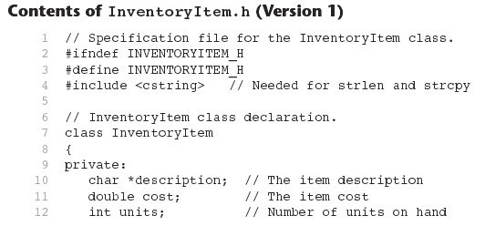
Destructors

Slide 86
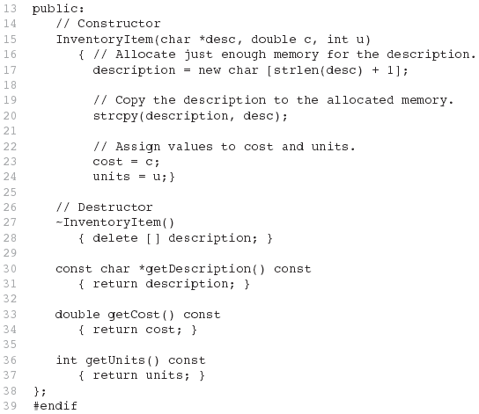
(continued)

Slide 87
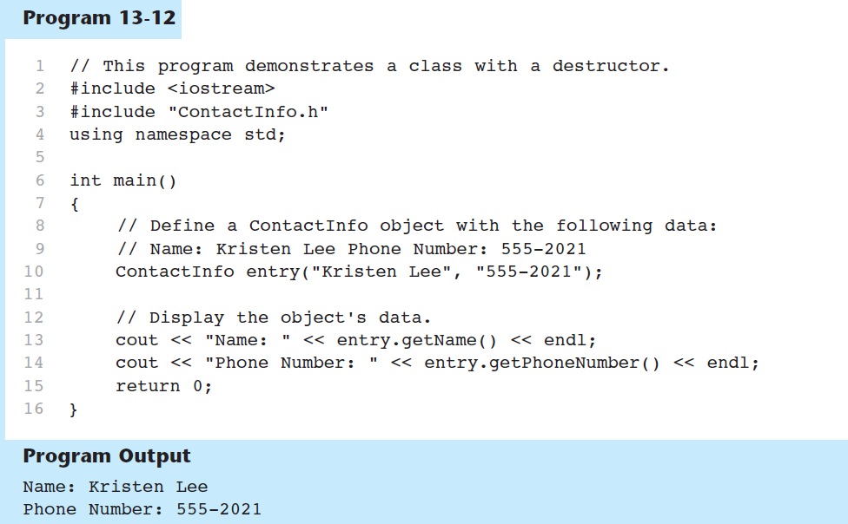

Slide 88
Constructors, Destructors, and Dynamically Allocated Objects
When an object is dynamically allocated with the new operator, its constructor executes: Rectangle *r = new Rectangle(10, 20);
When the object is destroyed, its destructor executes: delete r;

Slide 89
Overloading Constructors
A class can have more than one constructor
Overloaded constructors in a class must have different parameter lists:
Rectangle(); Rectangle(double);
Rectangle(double, double);

Slide 90
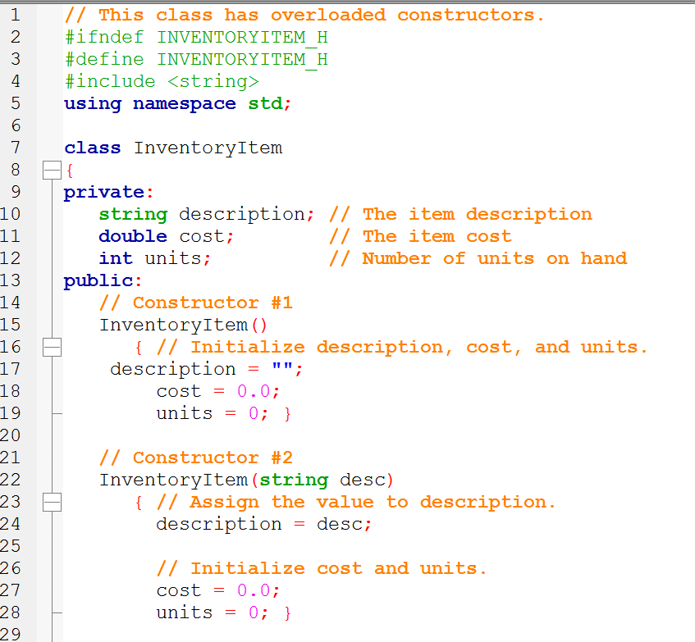
Overloading Constructors
Continues...

Slide 91
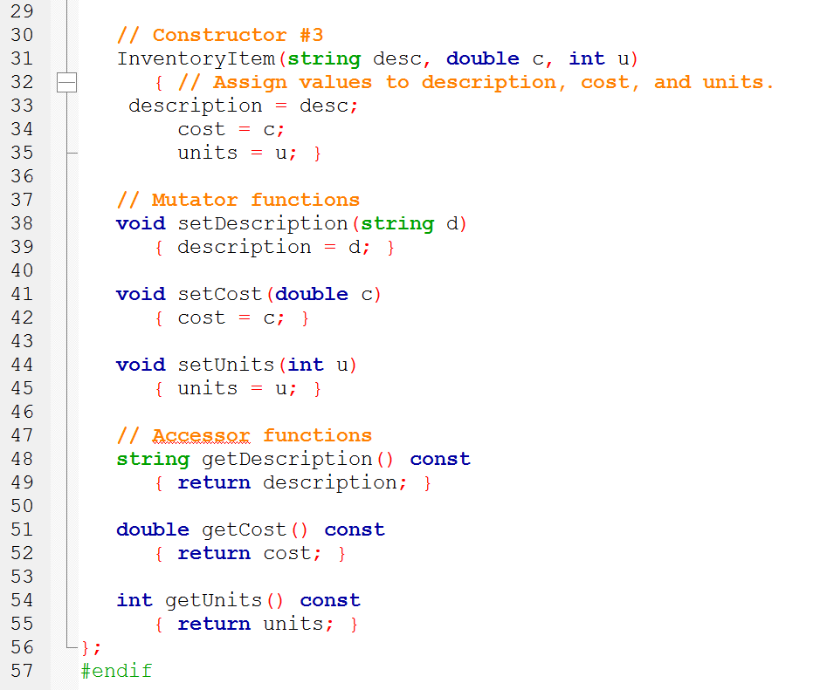
Overloading Constructors

Slide 92
Only One Default Constructor and One Destructor
Do not provide more than one default constructor for a class: one that takes no arguments and one that has default arguments for all parameters
Square();
Square(int = 0); // will not compile
Since a destructor takes no arguments, there can only be one destructor for a class

Slide 93
Constructors notes
A copy constructor is an (overloaded) constructor that has one parameter that is of the same type as the class. The one parameter must be a call-by-reference parameter, and normally the parameter is preceded by the const parameter modifier, so it is a constant parameter. In all other respects, a copy constructor is defined in the same way as any other constructor and can be used just like other constructors.
A copy constructor is used to initialize a newly declared variable from an existing variable.

Slide 94
Constructors notes
//=== file Point.hpp
class Point {
public:
. . .
Point(const Point &p); // copy constructor
. . .
//=== file Point.cpp
. . .
Point::Point(const Point & p) {
x = p.x;
y = p.y;
}
//=== file my_program.cpp
. . .
Point p; // calls default constructor
Point s = p; // calls copy constructor.
p = s; // assignment, not copy constructor.

Slide 95
Constructors notes
A copy constructor may be called whenever an object is copied by assignment, as a function parameter, or as a function return value. The copy constructor can be a time consumer if it involves allocation of memory or other resources. There are various ways to avoid this wasteful copying of memory blocks, for example:
Use a reference or pointer to the object instead of copying it
Use a "move constructor" to transfer ownership of the memory block. This requires a compiler with C++0x support.
Make a member function or friend function or operator that transfers ownership of the memory block from one object to another. The object that looses ownership of the memory block should have its pointer set to NULL.

Slide 96
Constructors notes
There should of course be a destructor that destroys any memory block that the object owns.
A destructor is as efficient as a member function. Do not make a destructor if it is not necessary.
Again, a simple constructor may be in-lined for improved performance

Slide 97
Constructors
Is move faster than a copy constructor?

Slide 98
Member Function Overloading
Non-constructor member functions can also be overloaded:
void setCost(double);
void setCost(char *);
Must have unique parameter lists as for constructors

Slide 99
Using Private Member Functions
A private member function can only be called by another member function
It is used for internal processing (like performing a calculation only when a value is stored in a particular member variable) by the class, not for use outside of the class
When we want this kind of behavior we should declare a member function private.
When it's private, it may only be called in internally.

Slide 100
Using Private Member Functions
class ContactInfo
{
private:
char *name; // The contact's name
char *phone; // The contact's phone number
// Private member function: initName
// This function initializes the name attribute.
void initName(char *n)
{ name = new char[strlen(n) + 1];
strcpy(name, n); }
// Private member function: initPhone
// This function initializes the phone attribute.
void initPhone(char *p)
{ phone = new char[strlen(p) + 1];
strcpy(phone, p); }

Slide 101
Aggregation
Aggregation: a class is a member of a class
Supports the modeling of ‘has a’ relationship between classes – enclosing class ‘has a’ enclosed class
Same notation as for structures within structures - aggregation happens when a class contains another instance of another class.

Slide 102
Aggregation
class StudentInfo
{
private:
string firstName, LastName;
string address, city, state, zip;
...
};
class Student
{
private:
StudentInfo personalData;
...
};

Slide 103
Concept | Description
Class member functions | A member function of a class is a function that has its definition or its prototype within the class definition like any other variable.
Class access modifiers | A class member can be defined as public, private or protected. By default members would be assumed as private.
Constructor & destructor | A class constructor is a special function in a class that is called when a new object of the class is created. A destructor is also a special function which is called when created object is deleted.
C++ copy constructor | The copy constructor is a constructor which creates an object by initializing it with an object of the same class, which has been created previously.
C++ friend functions | A friend function is permitted full access to private and protected members of a class.
C++ inline functions | With an inline function, the compiler tries to expand the code in the body of the function in place of a call to the function.
The this pointer in C++ | Every object has a special pointer this which points to the object itself.
Pointer to C++ classes | A pointer to a class is done exactly the same way a pointer to a structure is. In fact a class is really just a structure with functions in it.
Static members of a class | Both data members and function members of a class can be declared as static.

Slide 104
Revisiting inheritance – Terminology and Notation
Base class (or parent) – inherited from
Derived class (or child) – inherits from the base class
Notation:
class Student // base class
{
. . .
};
class UnderGrad : public student
{ // derived class
. . .
};

Slide 105
Back to the ‘is a’ Relationship
An object of a derived class 'is a(n)' object of the base class
Example:
an UnderGrad is a Student
a Mammal is an Animal
A derived object has all of the characteristics of the base class
class FinalExam : public gradedActivity

Slide 106
What Does a Child Have?
An object of the derived class has:
all members defined in child class
all members declared in parent class
An object of the derived class can use:
all public members defined in child class
all public members defined in parent class

Slide 107
What Does a Child NOT Have?
An object of the derived class does not have:
its constructors and its destructor
its assignment operator members (operator=)
its friends
its private members

Slide 108
Efficiency notes regarding Classes
Class data members (properties)
Recall the data members of a class or structure are stored consecutively in the order in which they are declared whenever an instance of the class or structure is created.
There is no performance penalty for organizing data into classes or structures.
Accessing a data member of a class or structure object takes no more time than accessing a simple variable.

Slide 109
Efficiency notes regarding Classes
class S2
{
public:
int a[100]; // 400 bytes.
// first byte at 0, last byte at 399
int b; // 4 bytes.
// first byte at 400, last byte at 403
int ReadB() {return b;}
};
If the offset relative to the beginning of the structure or class is 128 bytes or more then the offset has to be expressed as a 32-bit number (the instruction set has nothing between 8 bit and 32 bit offsets).

Slide 110
Efficiency notes regarding Classes
class S2
{
public:
int b; // 4 bytes.
// first byte at 0, last byte at 3
int a[100]; // 400 bytes.
// first byte at 4, last byte at 403
int ReadB() {return b;}
};
This makes the code more compact so that the code cache is used more efficiently.

Slide 111
Efficiency notes regarding Structs
Rule: big arrays and other big objects come last in a structure or class declaration and the most often used data members come first.
If it is not possible to contain all data members within the first 128 bytes then put the most often used members in the first 128 bytes.

Slide 112
Efficiency notes regarding Classes
Class member functions (methods)
Each time a new object of a class is declared or created it will generate a new instance of the data members. But each member function has only one instance. The function code is not copied because the same code can be applied to all instances of the class.
Calling a member function is as fast as calling a simple function with a pointer or reference to a structure.

Slide 113
Efficiency notes regarding Classes
class S3
{
public:
int a;
int b;
int Sum1() {return a + b;}
};
int Sum2(S3 * p) {return p->a + p->b;}
int Sum3(S3 & r) {return r.a + r.b;}
The three functions Sum1, Sum2 and Sum3 are doing exactly the same thing and they are equally efficient. If you look at the code generated by the compiler, you will notice that some compilers will make exactly identical code for the three functions. Sum1 has an implicit 'this' pointer which does the same thing as p and r in Sum2 and Sum3.

Slide 114
Efficiency notes regarding Classes
Rule: make member functions faster by making them static if they don't need any non-static access.
A static member function cannot access any non-static data members or non-static member functions. A static member function is faster than a non-static member function because it doesn't need the this pointer.

Slide 115
Efficiency notes regarding Classes
Rule: turn RTTI off and use alternative implementations.
Runtime type identification (RTTI). Runtime type identification adds extra information to all class objects and is not efficient. If the compiler has an option for RTTI then turn it off and use alternative implementations.

Slide 116
Q & A
What is a c++ struct? Is it a class?
How do you refer to items in the struct?
Can we compare structs?
How do you code to reference fields in nested structures?
Create a pointer named ptr and set it to the struct called bigStruct.
Access the item stuff in bigStruct using the pointer ptr.

Slide 117

Objects are better than ice cream!

Slide 118
References
Slide contributions include:
Walter Savitch, Problem solving with C++ (9th Edition). Addison-Wesley Longman Publishing Co., Inc. Boston, MA, USA ©2015
Gaddis, Starting Out with C++: From Control Structures through Objects, (8th Ed.) , Addison-Wesley Longman Publishing Co., Inc. Boston, MA, USA ©2015
Bjarne Stroustrup, The C++ Programming Language, 3rd Edition, Addison-Wesley Longman Publishing Co., Inc. Boston, MA, USA ©2007
Herb Sutter, Andrei Alexandrescu, C++ coding standards : 101 rules, guidelines, and best practices, Copyright © 2005 Pearson Education, Inc.
Frank M. Carrano. Data Abstraction & Problem Solving with C++ (5th Edition)
Addison-Wesley Longman Publishing Co., Inc. Boston, MA, USA ©2006
Paul Deitel & Harvey Deitel, C++ How to Program, (7th Ed.) © 2010 by Pearson Education, Inc.
Upper Saddle River, New Jersey 07458

